Slide 1
FIFA WORLD CUP DATA ANALYSIS REPORT
BY DEBADRITA NEOGI

Slide 2
INTRODUCTION
The World Cup in football is a quadrennial tournament of 32 men's national teams that is organized by the Fédération Internationale de Football Association (FIFA). It determines the sport's men's world champion.

Slide 3
OBJECTIVE-
To get useful insights from the FIFA WORLD CUP
dataset and visualize to give some interesting figures to the football fans .
This project is based on FIFA World Cup Analysis to get insights about the Matches, patterns about players, Patterns about cup holders, Home Ground Advantage and many more things*

Slide 4
VISUALIZATION PROCESS
Collecting Data
The first and most important step of data visualization is gathering data in large amounts. Only after we have substantial data, we can apply data visualization techniques on the collected data
and get some helpful insights from it.

Slide 5
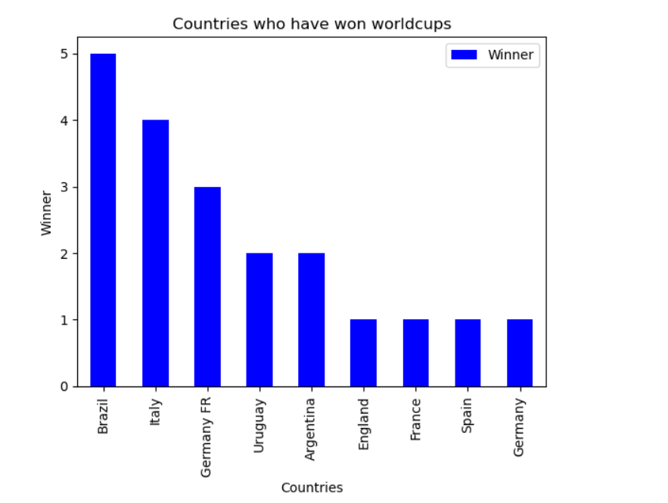
VISUALIZATION
SO THIS IS THE GRAPH OF COUNTRIES WHO HAVE WON WORDCUPS MOST AND IN GRAPH WE CAN CLEARLY SEE BRAZIL WON THE WORLDCUPS MOST.

Slide 6
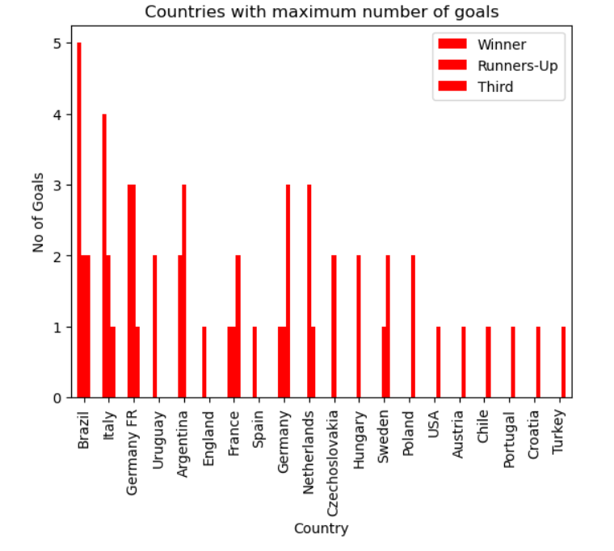
THIS IS FIGURE OF COURTRIES WHO HAVE MAXIMUM NUMBER OF GOALS…

Slide 7
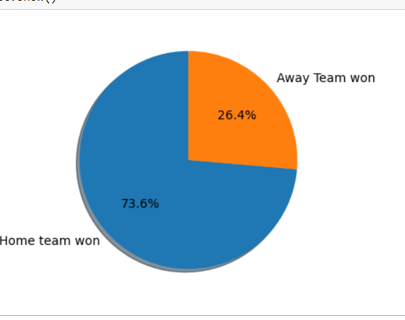
MATCH OUTCOMES HOME TEAM AND AWAY TEAM

Slide 8
CONCLUSION
In summary, a comprehensive conclusion for a data analysis in a research study involves a strategic synthesis of key findings, their implications, and their contribution to the broader field of study. It is an opportunity to communicate the significance of your research and guide future investigations.

